Slide 1


Anti-state comment detection on social media using NLP
Group Members:
Arsalan Javed
Raaz Khan
Arsal Sana
Daniyal Azfar
Supervisor:
Dr. Wasi Haider Butt

Slide 2
Contribution
Problem statement
Introduction
Flow Diagram
System Level Diagram
Implementation:
Data Gathering
Feature Extraction
Reference
Relevant Work
Future work
GUI
Model Classifier
Model run on Test Data
Conclusion
Data Pre-processing
Presentation Outline

Slide 3

Group Member Contribution
Data Gathering, Annotation and Documentation – All members
Daniyal Azfar
Data extraction with web scraping
Raaz Khan
Data Pre-processing
Arsal Sana
Model testing and training
Arsalan Javed
Features extraction, model deployment and GUI

Slide 4

Problem Statement
There is a dire need to have an automated approach to separate obnoxious content about the state from normal to identify state insider enemies

Slide 5

Introduction
Social networking platforms; a recent attraction for all
Many use social sites to express their emotions, beliefs or opinions about things, places or personalities.
Anti-state comments including the hate comments and tweets against the country badly effect the country image

Slide 6
Relevant Work
Sentiment Analysis on Imran Khan Tweets ,a research paper in which they gather and analyzed sentiment of tweets made by Imran Khan in one year time. Polarity of Imran Khan’s tweet was analyzed with help of R’s studio. Polarity result shows all three positive, neutral and negative tweets.
DOI:10.33824/pjpr.2021.36.3.26
Sentiment Analysis for Urdu News Tweets Using Decision Tree, a research paper in which sentiment analysis is done on Urdu data. The approach uses dataset creation and then classification, which classifies tweets as positive, negative and neutral.
DOI: https://ieeexplore.ieee.org/document/8886788

Slide 7
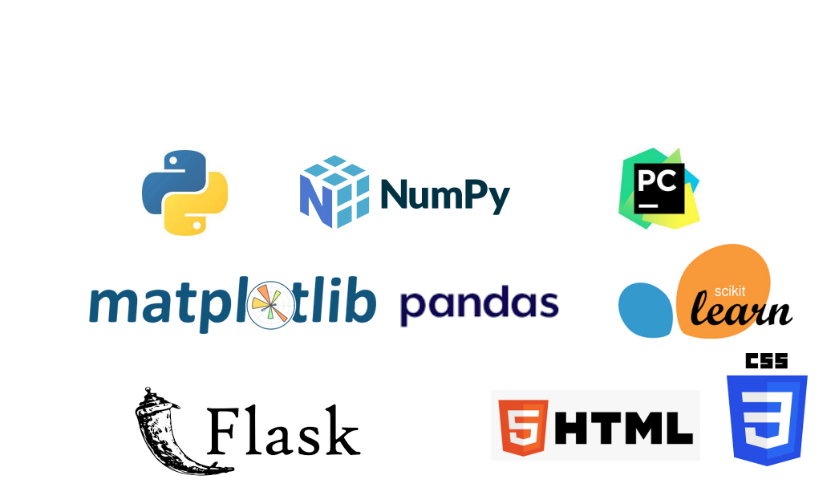
TOOLS/LIBRARIES USED

Slide 8
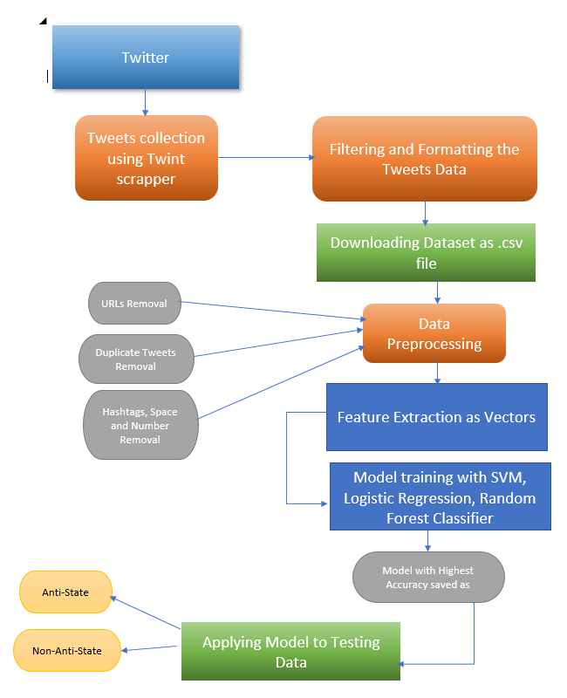
Flow Diagram

Slide 9
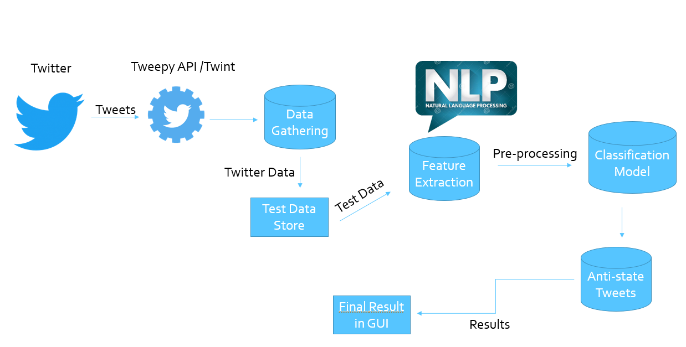
System Level Diagram

Slide 10

Implementation
SVM, Logistic Regression and Random Forest classification model used.
Selected the highest accuracy setup for testing the dataset.
Training is done on the custom-made dataset using Twint and Tweepy
Total of 1640 tweets extracted and labelled for the training dataset.
Train/Test split- 80% training, 20 % testing set.
Pre-processing steps done on the dataset to clean the unstructured data of the text
Features extracted from the dataset as vectors on basis of frequency of word occurrence using the Count vectorizer
Developed a GUI using Flask, Html, and CSS in python

Slide 11
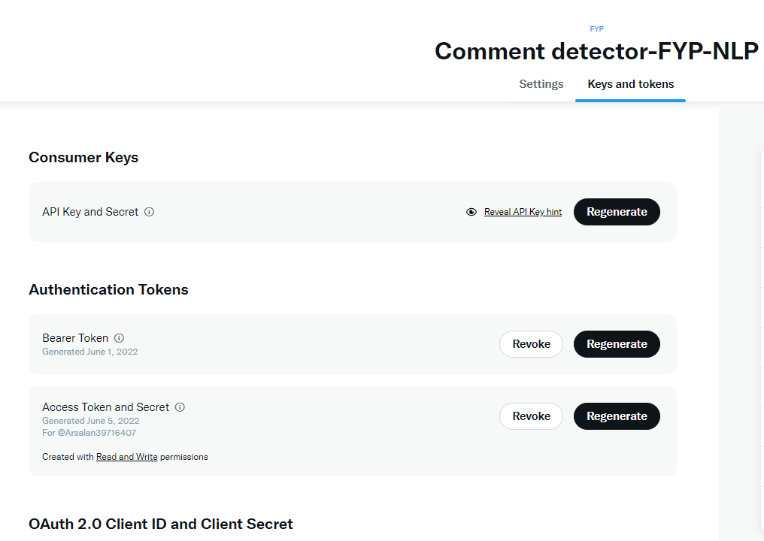
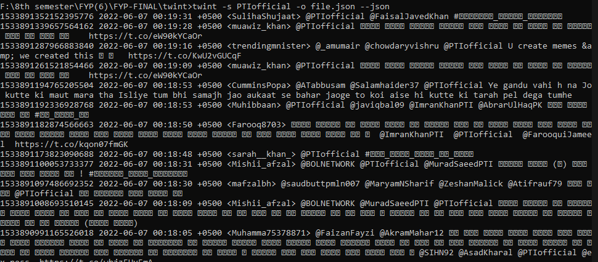
Data Gathering
Use of Twint, for scrapping twitter
Tweepy also used but due to the limited version of API keys limited data can be extracted only

Slide 12
Dataset Creation
Tweets gathered were saved in a .csv file
Dataset contains “Tweets”, “User Id”, “Retweets”, “Labels” etc.
Extracted tweets were cleaned using a filter code in python in which all irrelevant columns like “Re-tweets” etc. were removed for simplicity
Label “0” means Non-Anti State and “1” means “Anti-State”
Tweets are collected using hashtags and only contains Tweet related to Pakistan

Slide 13
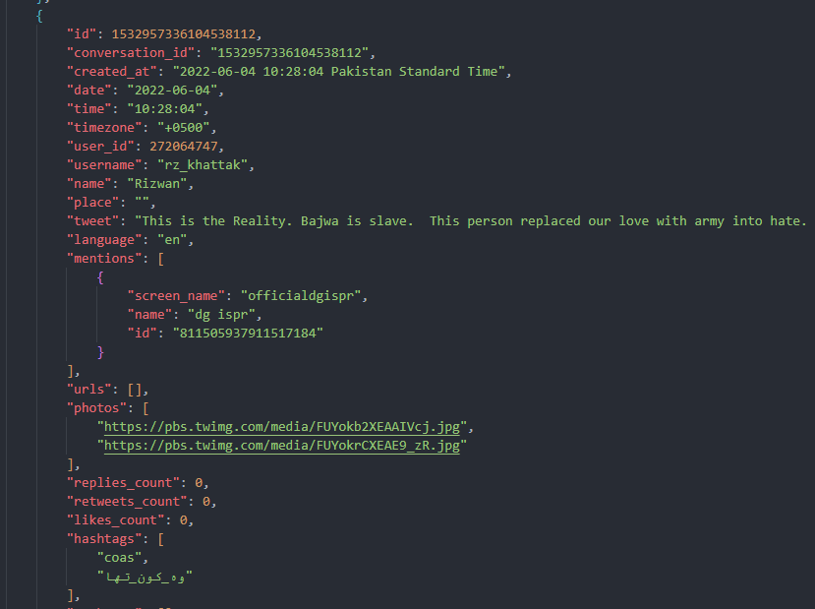
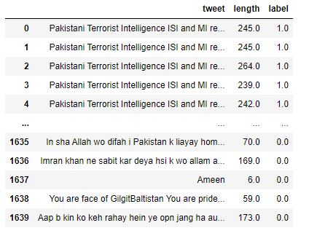
Unstructured Data of Tweets Gathered
Data simplified for Training

Slide 14
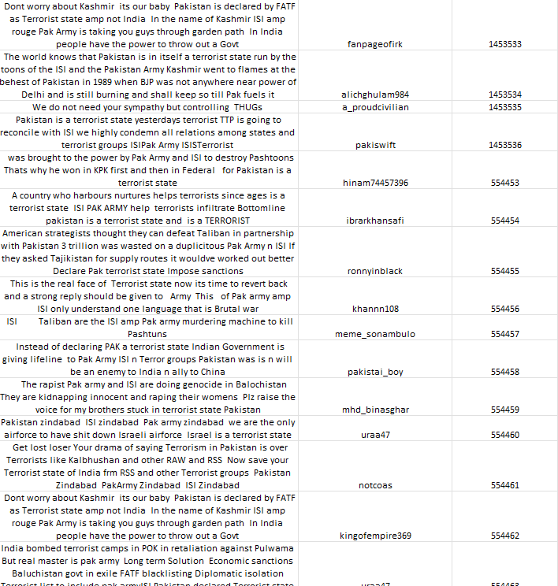
Our Dataset We have worked on a tweet's dataset extracted directly from a Twitter

Slide 15
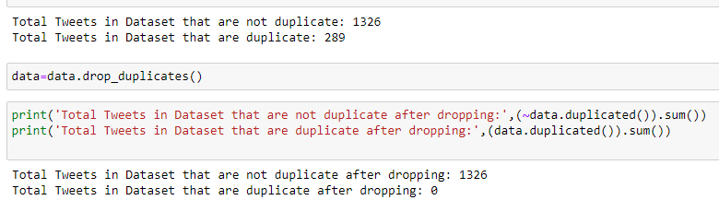
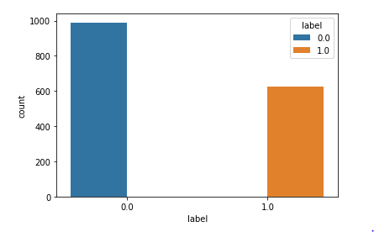
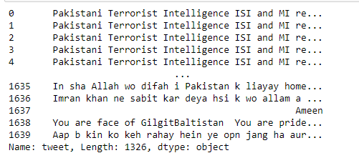
Dataset Pre-processing
Removal of Duplicate Tweets
Determine Balance Notion of Dataset with both labels
Removing spaces, digits, URLs, Hashtags and images from tweets

Slide 16

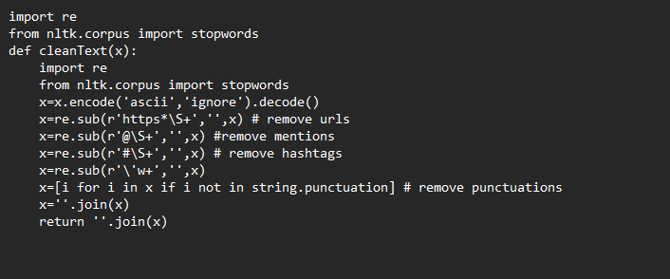
Dataset Pre-processing

Slide 17
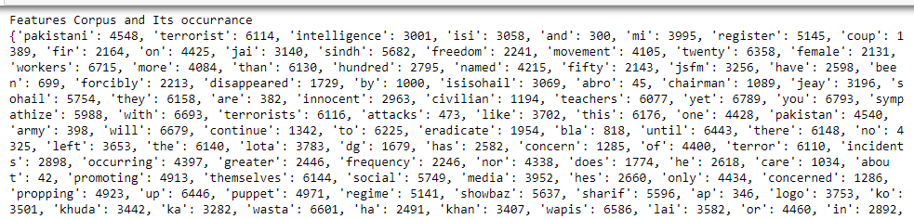
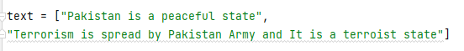
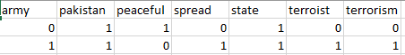
Feature Extraction
Machines cannot understand characters and words, so need to convert text into numbers when dealing with text data
Count vectorizer is a method to convert text to numerical data. It is used to transform a given text into a vector based on the frequency (count) of each word that occurs in the entire text
Each input is pre-processed, tokenized, and represented as a sparse matrix. By default, Count vectorizer converts the text to lowercase and uses word-level tokenization.

Slide 18
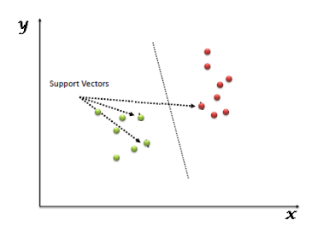
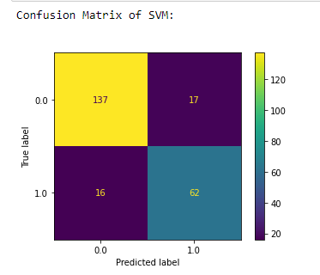
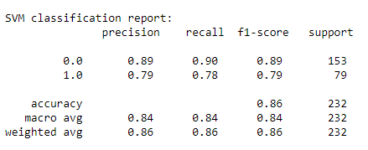
Support Vector Machine (SVM)
SVM is the machine learning classifier that best separates the two classes
It uses kernel in its implementation. We used a ‘linear’ kernel. Kernel transforms data space into the required form. My kernel trick technique converts data from low dimensional space to high dimensional space

Slide 19
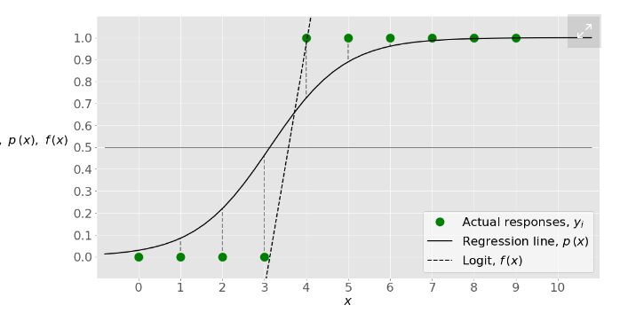
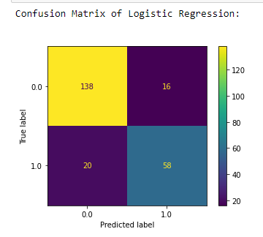
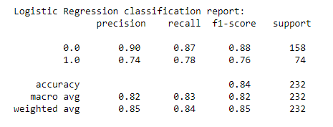
Logistic Regression
Logistic Regression is a classification algorithm which predicts the probability of class dependence.
The dependent variable is the binary variable. In our project, it is 0: Non-Anti State 1: Anti-State
The logistic regression function 𝑝(𝐱) is the sigmoid function of 𝑓(𝐱): 𝑝(𝐱) = 1 / (1 + exp(−𝑓(𝐱)).

Slide 20
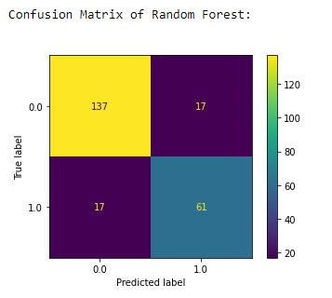
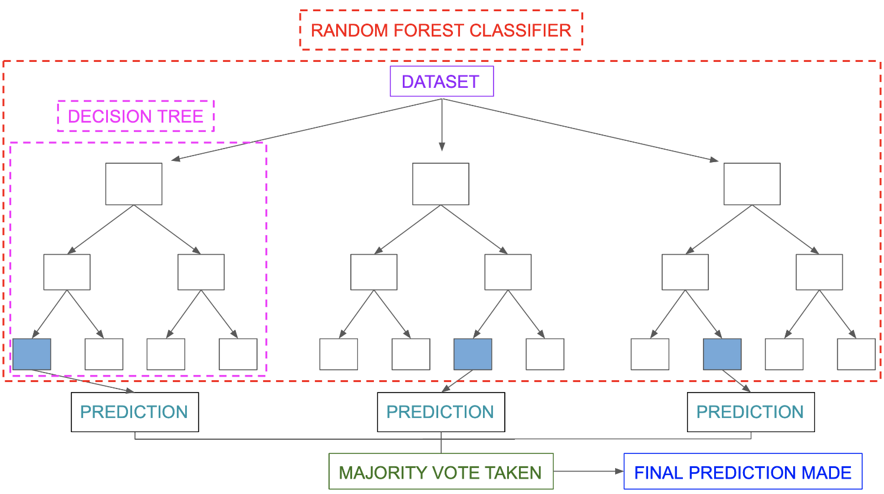
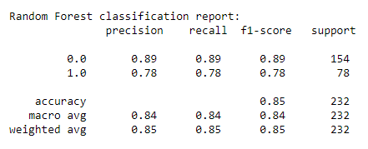
Random Forest
A random forest is a classifier that uses several decision trees on a sub-sample of datasets and calculates the average to increase the accuracy of test data prediction this process controls the over-fitting of the dataset

Slide 21
Accuracy of Classifiers
Classifier | Accuracy
Support Vector Machine (SVM) | 86.0%
Logistic Regression | 84.7%
Random Forest | 86.4%
We choose Random Forest Classifier for building or model

Slide 22
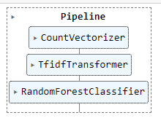
Building Pipeline model
A machine learning pipeline created
The pipeline created by putting the features involved in training the model that was intended to be used for our dataset and the classifier in sequenced steps.
This process automated the workflow of machine learning.
After creating the pipeline, we saved our pipeline model using the pickle python library to be reused afterwards

Slide 23
GUI Functioning
Admin use
Sign-in /Sign-up
Logout
Home Page
Twitter Information
Objectives
Coding platform used
Get Started
File input of Test data
No. of tweets to display in output
Table showing info of tweet its labels and user information
GUI run on Flask python on http://127.0.0.1:5000/

Slide 24
GUI Functioning
Flask
Small/lightweight python web framework
Development server and debugger
Jinja2 templates
To create HTML, markup formats are returned to the user via an HTTP request.
WSGI
Interface between web servers and web apps

Slide 25
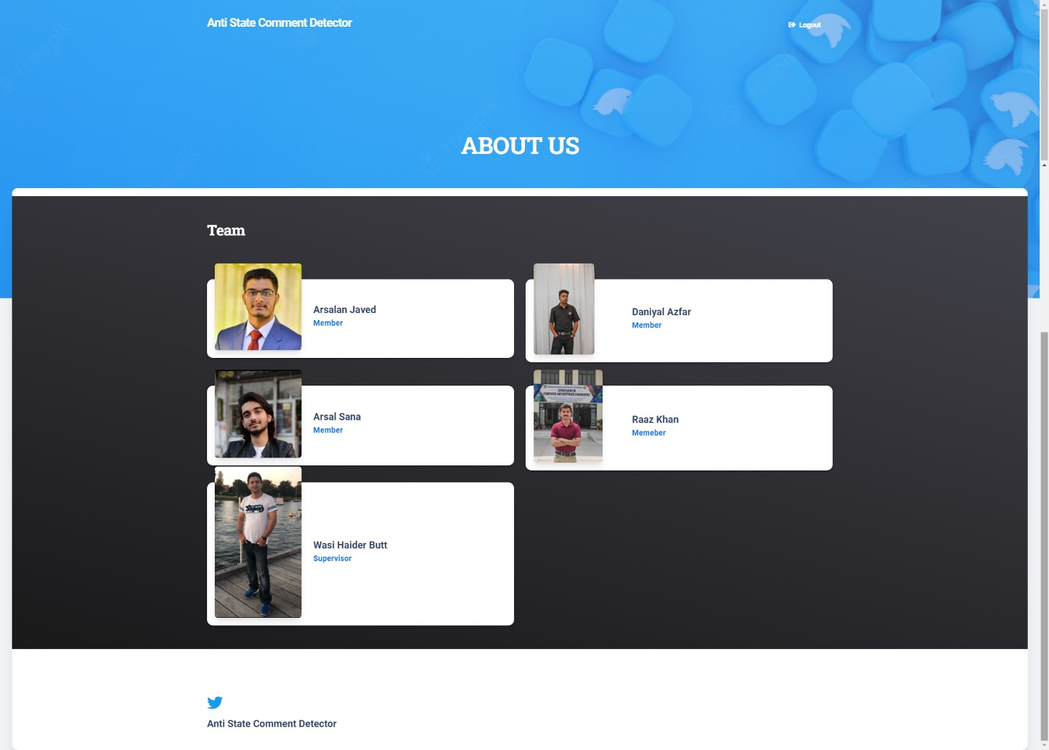
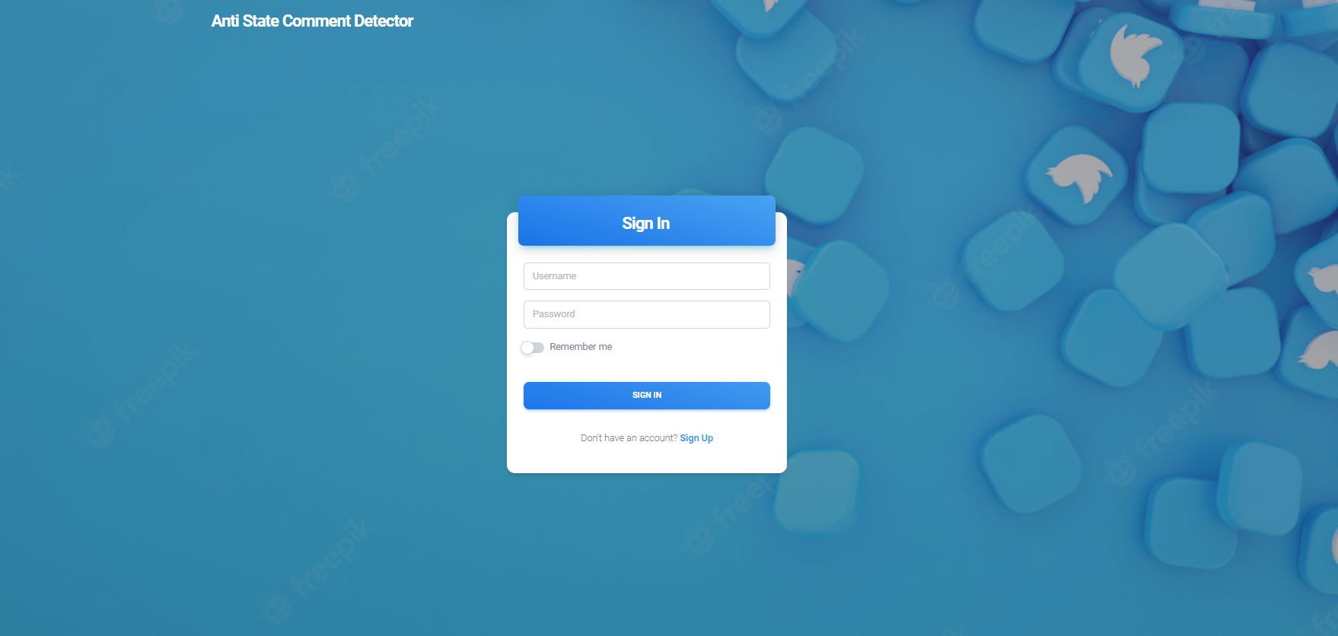
GUI Functioning
About Us
Sign-in/Sign-up

Slide 26
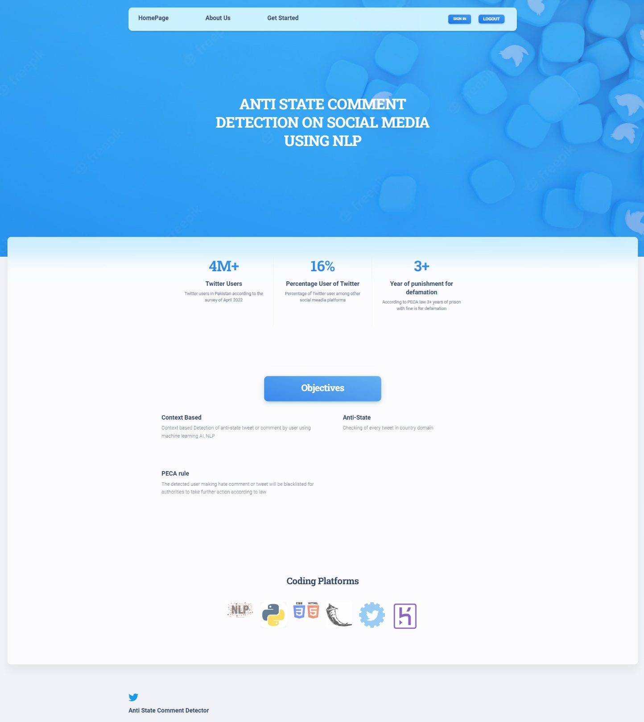
GUI Functioning
Home Page

Slide 27
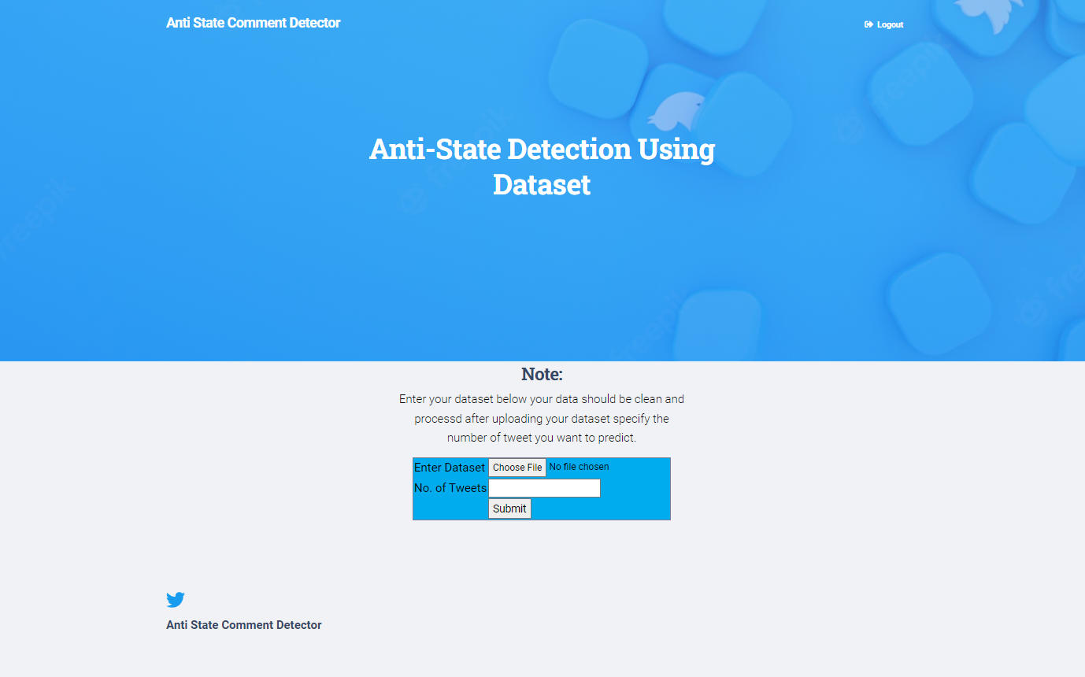
GUI Functioning
Get Testing Data

Slide 28
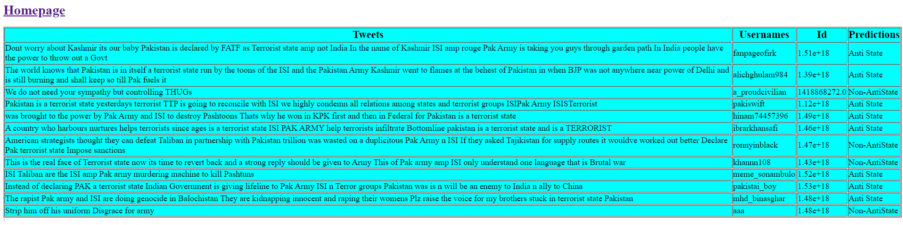
GUI Functioning
Output Showing

Slide 29
Conclusion
It is a world of social media warfare, and everyone have freedom of expiring their thoughts and opinion on topics
Some social media users try to spread negativity and hate among other for country, institution or person. Defamation of any kind is not acceptable in our law and is punishable
Finding such users and restricting their use of social media for spreading negativity and hate can be achieved to some extent in our project

Slide 30
Future Work
Adding more tweets to the dataset.
01
By applying for v1 Twitter API key, real-time analysis and training on tweets can be made.
02
Extended project to detect defamation not only of the state but instead also detect Racism, sexism, homophobia, religious extremism, and conspiracy theories.
03
Can implement it using run-time search of single tweet instead of uploading file
04

Slide 31
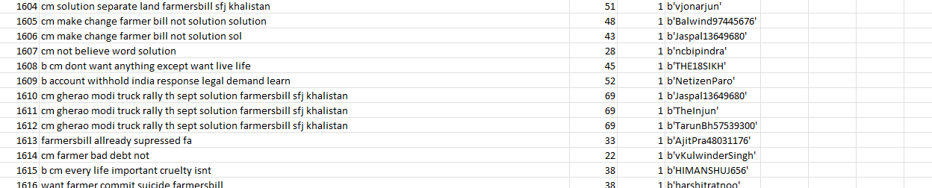
Challenges
Tweepy Account access
Got the Tweepy essential access account but needed elevated access but couldn’t get in on time
Elevated account has a limit of 200 tweets per search
If you use the same keyword for the tweets extraction the keys expire
Data Augmentation
We tried to use data Augmentation for the training data but created chunks of data that were not good for our model
Deployment on Heroku
The free size on Heroku which was given was much less than our project size for deployment.

Slide 32
References
Twitter survey report
https://datareportal.com/reports/digital-2022-pakistan
PECA article
https://mediacommissionreview.org/article-19-19-a-of-the-constitution-of-pakistan/
Defamation Law,
https://rsf.org/en/online-defamation-pakistan-now-punishable-five-years-prison
Sentiment Analysis on Imran Khan’s tweet,
https://www.researchgate.net/publication/355071921_Sentiment_Analysis_of_Imran_Khan's_Tweets ,
Sentiment Analysis on Urdu News Tweets using Decision Tree
R. Bibi, U. Qamar, M. Ansar, and A. Shaheen, "Sentiment Analysis for Urdu News Tweets Using Decision Tree," 2019 IEEE 17th International Conference on Software Engineering Research, Management and Applications (SERA), 2019, pp. 66-70, doi: 10.1109/SERA.2019.8886788.
Sentiment Analysis of Pakistani Twitter,
https://nayadaur.tv/2020/03/sentiment-analysis-of-pakistani-twitter-dg-ispr-cm-murad-more-popular-than-pm/

Slide 33


